Slide 1
Bank Analytics
Analytics for Stakeholders

Slide 2
Objective
The objective of this project is to analyze banking data and create an interactive dashboard that helps stakeholders monitor bank performance, customer behavior, loan trends, and financial risks for better decision-making.

Slide 3
Problem Statement
Banks generate large volumes of customer and transaction data daily. However, without proper analysis, it becomes difficult for stakeholders to identify:
Loan default trends
Customer segmentation
Revenue performance
Branch-wise efficiency
Risky customers and loans
Overall business growth patterns
This project aims to transform raw banking data into meaningful insights through analytics and dashboards.

Slide 4
Data Cleaning Steps
1. Removed rows containing missing/null values in important columns.
2. Removed empty columns that contained no useful data.
3. Removed the State Abbr column as it was duplicated information of the State abbr column.
4. Replaced null values in BH Name with "Unknown".
5. Replaced null values in Caste with "Unknown".
6. Replaced null values in Credit Officer Name with "Unknown".
7. Replaced null values in Disb By with "Unknown".
8. Converted Closed Date column to proper date format.
9. Converted Date of Birth column to proper date format.
10. Converted Disbursement Date column to proper date format.
11. Replaced "state names" in State name column full state names for better readability and consistency.

Slide 5



Calculated Field
Total Loan Amount Funded: Measures the total value of loans disbursed.
Total Loan Amount Funded represents the overall amount of money disbursed by the bank to customers as loans
It helps stakeholders understand the bank’s lending activity and overall business performance.
Sum (Funded Amount)
Total Loans: Tracks the number of loans issued.
Total Loans represents the total number of loans issued or approved by the bank during a specific period.
It is calculated by counting the total loan entries in the dataset.
Total Loans = COUNT([Account ID])
Total Collection: Reflects repayment performance, including principal and interest.
Total Collection represents the total amount recovered by the bank from customers against issued loans. It includes:
Principal Amount Repayment
Interest Amount Payment
This KPI helps measure the bank’s repayment and recovery performance.
SUM([Total Rec Prncp]) + SUM([Total Rrec int])

Slide 6

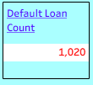
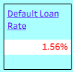
Calculated Field
Total Interest: Captures revenue from loan interest.
Total Interest represents the total revenue earned by the bank from the interest charged on loans provided to customers.
It is one of the key financial metrics used to measure the bank’s profitability from lending operations.
SUM([Total Rrec int])
Default Loan Count: Counts loans in default.
Default Loan Count represents the total number of loans where customers failed to repay the loan as per the agreed terms and the loan is marked as “Y” in “Is default Loan” column .
This KPI helps banks identify the volume of risky or non-performing loans.
Default Loan Count : SUM(IF [Is Default Loan]=='Y' THEN 1 ELSE 0 END)
Default Loan Rate: Proportion of defaulted loans to the total portfolio.
Default Loan Rate represents the percentage of loans that borrowers failed to repay compared to the total number or value of loans issued by the bank.
It is an important KPI used to measure the bank’s credit risk and loan portfolio health.
Default Loan Rate : [Default Loan Count]/COUNT([Account ID])

Slide 7



Calculated Field
Delinquent Client Count: Tracks borrowers with missed payments.
Delinquent Client Count represents the total number of borrowers who have missed their loan payments or failed to pay installments on time.
These customers are considered financially risky and require monitoring by the bank.
Delinquent Client Count : COUNTD(
IF [Is Delinquent Loan] = 'Y'
THEN [Client id]
END
Delinquent Loan Rate: Percentage of loans overdue in the portfolio.
Delinquent Loan Rate represents the percentage of loans in the bank’s portfolio that are overdue or unpaid beyond the due date.
It is an important KPI used to measure loan repayment performance and credit risk.
[Delinquent Client Count]/ COUNT([Account ID])
No Verified Loans: Identifies loans without proper verification.
No Verified Loans represent the number of loans that were approved or processed without completing proper verification checks such as income verification, identity verification, employment verification, or document validation.
IF [Verification Status] = "Not Verified"
THEN 1
ELSE 0
END

Slide 8
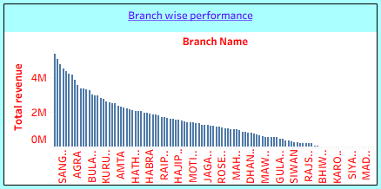
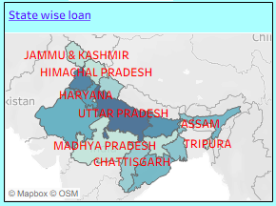
Charts
Branch-Wise Performance: Analyzes revenue (interest, fees, total) by branch.
Branch-Wise Performance analyzes and compares the financial performance of different bank branches based on revenue
State-Wise Loan: Shows geographic distribution of loans.
State-Wise Loan analysis shows the distribution of loans across different states or regions. It helps stakeholders understand which geographic areas contribute the highest or lowest loan amounts and customer activity.
This analysis is useful for identifying regional business performance and market opportunities.

Slide 9
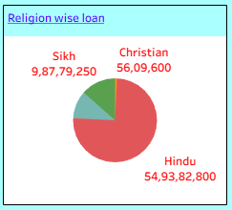
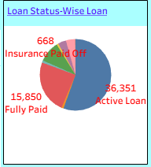
Charts
Religion-Wise Loan: Monitors loan distribution across religious demographics.
Religion-Wise Loan analysis shows how loans are distributed among customers belonging to different religious groups. This helps banks understand customer demographics and lending patterns across various communities.
Loan Status-Wise Loan: Breaks down loans by status (active, delinquent, closed).
Loan Status-Wise Loan analysis categorizes loans based on their current status

Slide 10
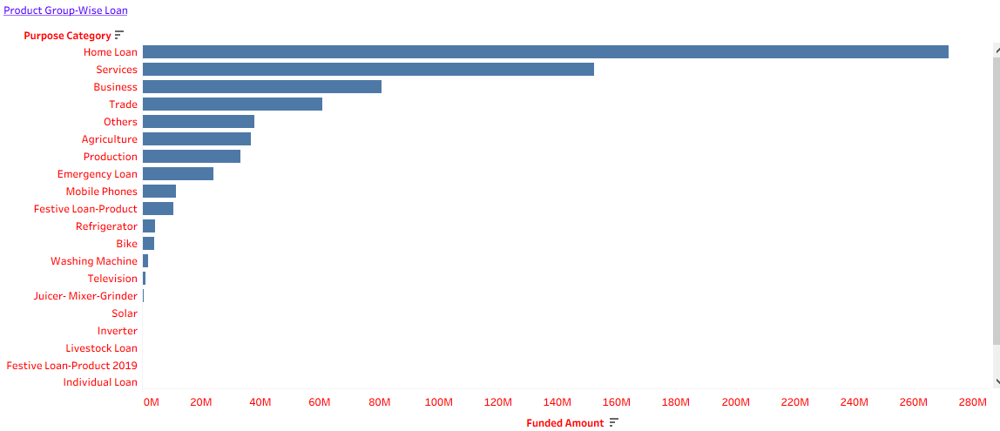
Charts
Product Group-Wise Loan: Categorizes loans by product types (e.g., personal, auto).

Slide 11
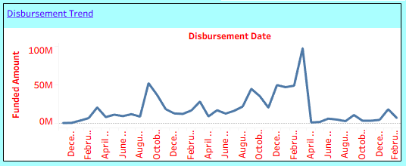
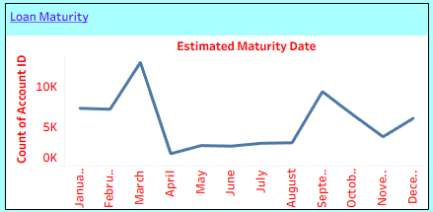
Charts
Disbursement Trend: Tracks changes in loan disbursements over time.
Disbursement Trend analysis tracks how loan amounts are distributed over a specific period .
It helps stakeholders understand lending patterns, business growth, and seasonal demand for loans.
Loan Maturity: Tracks the timeline until full repayment
No of terms :
INT(SPLIT([Term], " ", 2))
Estimated Maturity Date
DATEADD('month',[No of terms], [Disbursement Date])

Slide 12
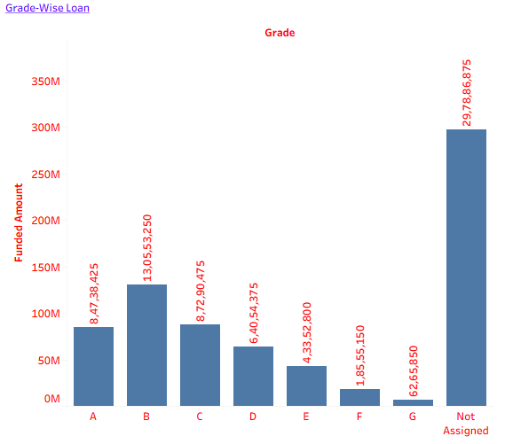
Charts
Grade-Wise Loan: Assesses portfolio risk by borrower credit grades.
Grade-Wise Loan analysis categorizes loans based on borrower credit grades assigned by the bank or lending system.
Credit grades indicate the borrower’s creditworthiness and repayment capability.
These grades help assess the risk level associated with each loan.

Slide 13
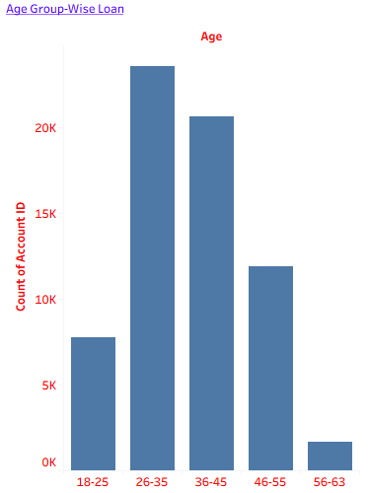
Charts
Age Group-Wise Loan: Categorizes loans by borrowers’ age groups.
Age Group-Wise Loan analysis categorizes loans based on borrowers’ age groups to understand which age segments borrow the most and how lending behavior varies across different age categories.
This helps banks analyze customer demographics and target suitable financial products.

Slide 14
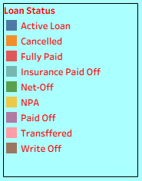
Slicer
The slicer contains the following loan statuses:
Active Loan → Loans currently running
Cancelled → Loans cancelled before completion
Fully Paid → Loans completely repaid
Insurance Paid Off → Loans settled through insurance
Net-Off → Loans adjusted internally by the bank
NPA (Non-Performing Asset) → Loans with overdue repayments
Paid Off → Loans successfully closed
Transferred → Loans transferred to another institution/account
Write Off → Loans considered unrecoverable by the bank
This slicer helps stakeholders:
Analyze specific loan categories
Monitor risky loans like NPA and Write-Off
Track active and completed loans
Improve loan portfolio analysis
Make faster business decisions

Slide 15
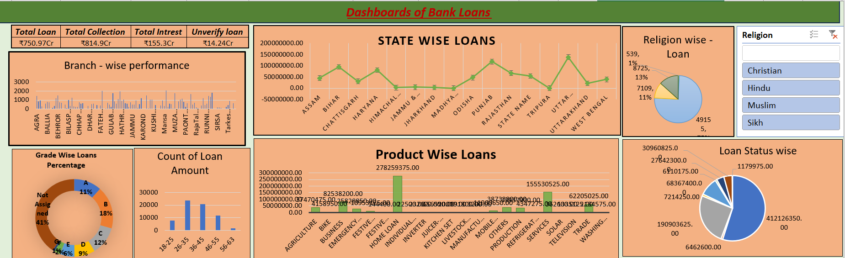
EXCEL DASHBOARD

Slide 16
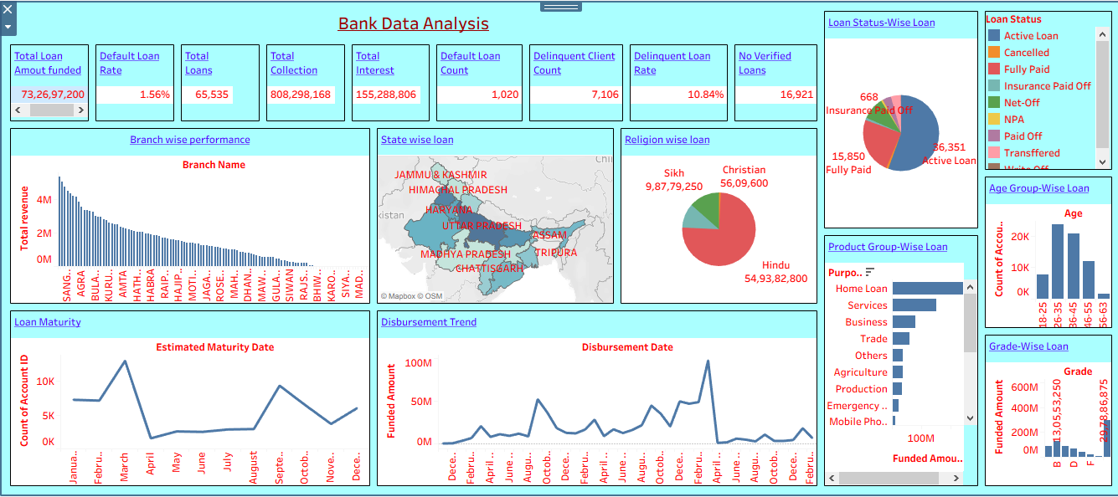
Tableau Dashboard

Slide 17
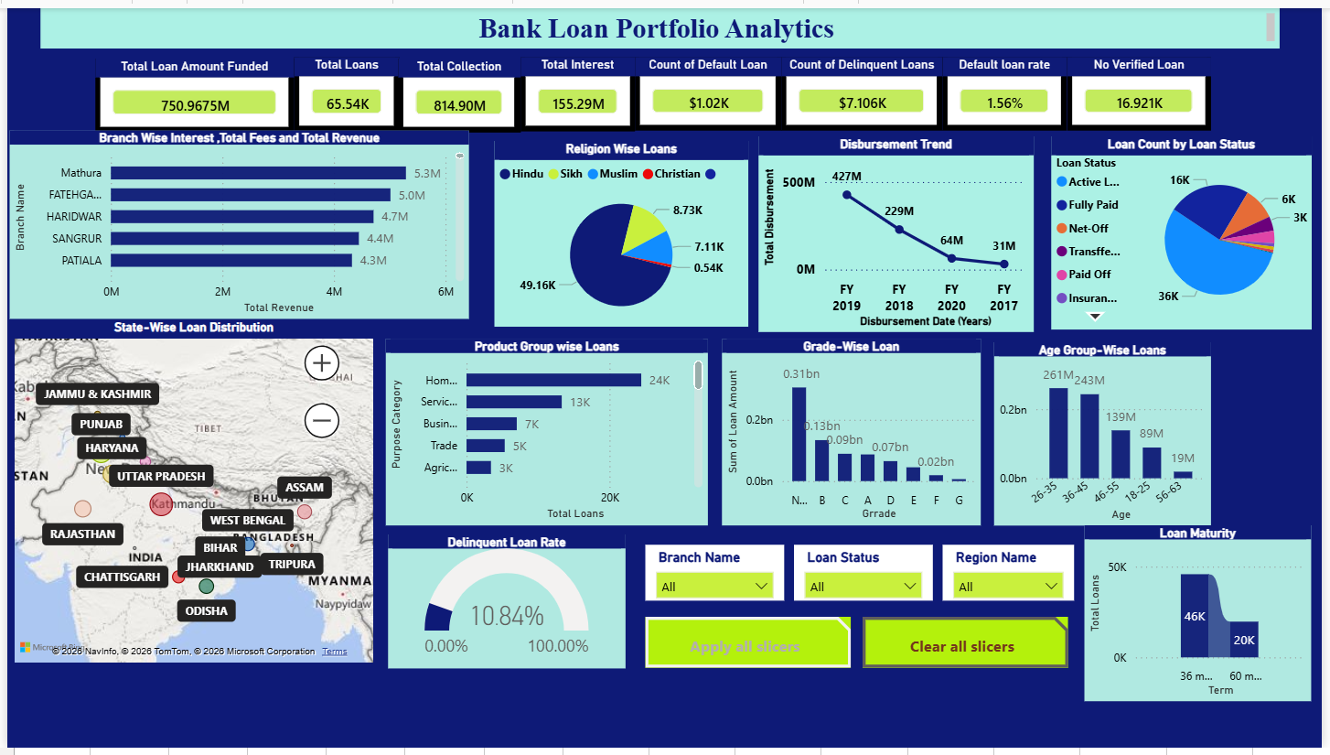
POWER BI DASHBOARD

Slide 18


